Slide 1
The sight Resolution Process For New/Newer Callers
Understand the process
Mel Wilkerson
28 Royce Crescent
Lavington NSW, Australia
wilkerso@bigpond.net.au
More than Just Understanding Symmetry and Moving Dancers from A to B

Slide 2
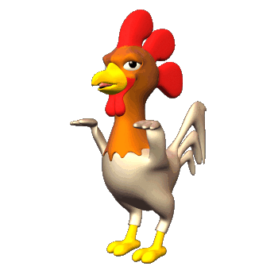
The Resolution Puzzle – Daunting Math
8 Dancer in 1 square = 706,480,718,267,000,000,000,000
2x4 Grid – 2,642,411,520 combinations
2x4 Grid with Symmetry = 384 combinations If we know the foundation it is only 96 combinations
6 Arrangements, 4 sequences, 4 relationships
These are expressed in terms of FASR

Slide 3
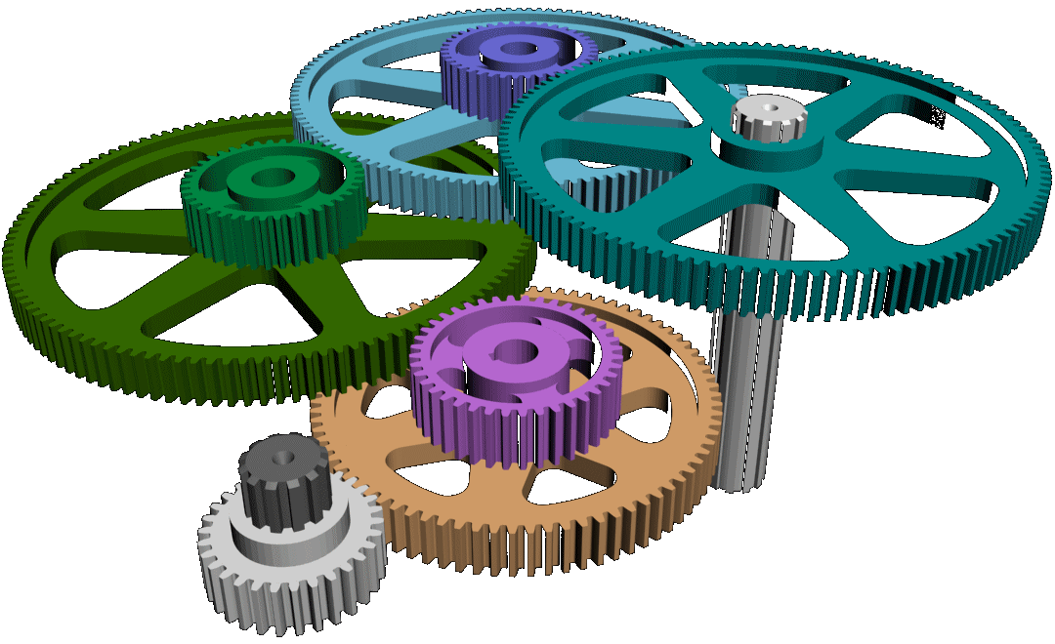
Let’s make it simple only 3 parts to “Sight Resolution”
Preparation – Identifying your key couples
Movement Mechanics – Moving the dancers Like a well oiled machine
GET OUT – Module or Technique
You must know the basics of formation management and movement mechanics

Slide 4
6 Step Process
Get the Dancers Symmetric
Get to a Familiar Formation (standard arrangement)
Pair up one key couple
Find the other key couple in the square
Translate the FASR or move them to the desired FASR
Call the Get out technique or resolution Module
We will look at these one by one

Slide 5
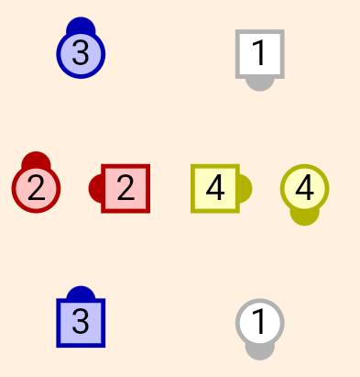
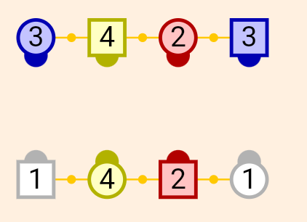
Resolution process - Step 1 - Symmetry
Choose a square that is Symmetric and recognisable
If not there get them there quickly
Nothing wrong with a best guess
This
Not this
If you are relaxed – they will be too

Slide 6
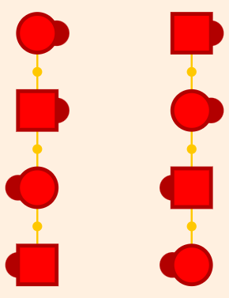
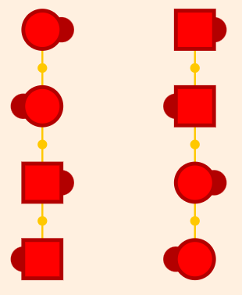
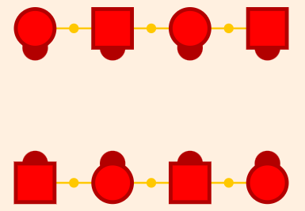
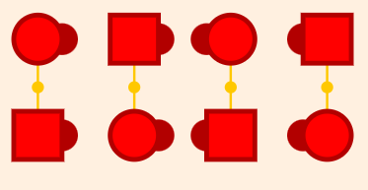
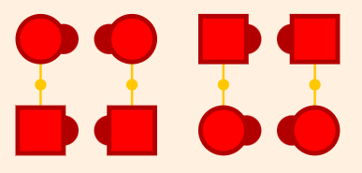
Step 2 – Known Formation & Standard Arrangement
Before searching for partners
Get to somewhere familiar
Normal & standard arrangements.
Facing Lines
8-Chain Four
R-H Ocean Waves
Double Pass thru
2- Face Lines
Gives you and dancers comfort – get them normal and keep them normal
Understand movement mechanics
Understand what causes difficulty
Start with Memorised Modules for Variety

Slide 7
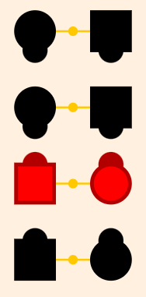
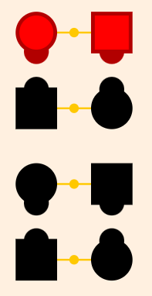
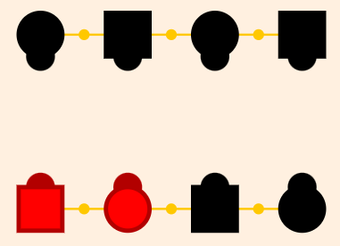
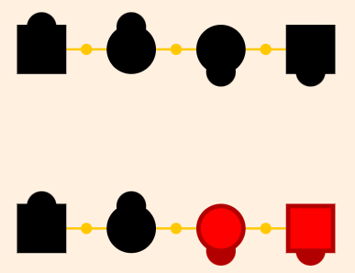
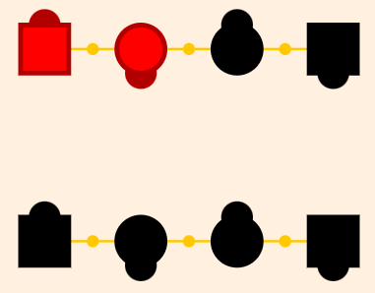
Step 3 – Pairing
Partner pairing means having a Key couple together and normal
Symmetry now applies
Use as few moves as possible to pair.
Facing Lines
8-Chain Four
R-H Ocean Waves
Double Pass thru
2- Face Lines
Get them Together – Keep them Together

Slide 8
Step 4 – Find the Secondary Couple
When one is paired keep them paired
Only four other places the other can be – 2 for boys and 2 for girls.
You know where one paired couple is – now it is looking at the other.
Facing Lines
8-Chain Four
R-H Ocean Waves
Double Pass thru
2- Face Lines
Only four options
“S” Couple, Not “S” Couple, “S” Boy, “S” Girl

Slide 9
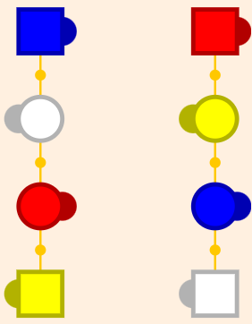
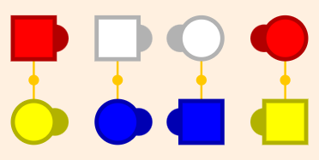
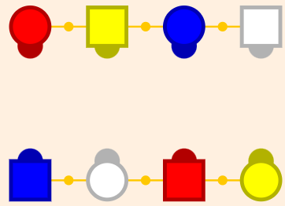
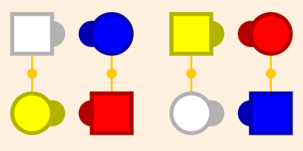
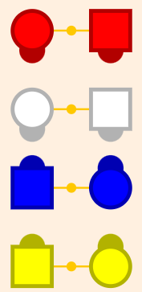
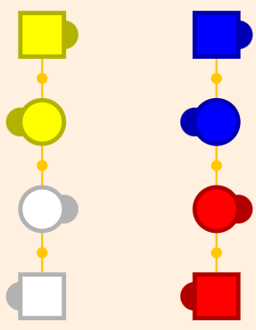
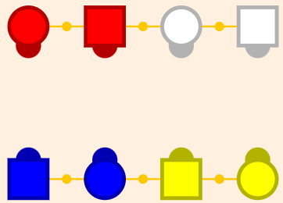
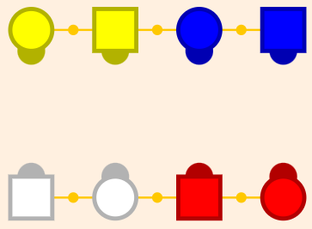
Helpful Pairing Trick – when nobody paired?
A few useful flow modules for a pairing purpose
Standard 8 Chain 4 formation - Pass Thru, trade by
Standard R-H Wave formation – All 8 Circulate
Standard Double Pass thru – Double Pass Thru, Cloverleaf
Standard Facing Lines – Star Thru, Pass Thru, Trade By, Star Thru
1
2
3
4
Lots of others but remember these 4

Slide 10
Step 5 – Evaluate the FASR
With one couple paired – there are only 4 ways the other couple can be
Question 1 – Is the other (secondary) couple Paired? – YES or NO
Question 2 – Are they in sequence or out of sequence – IN or OUT
Use Familiar Formation to you:
Facing lines
Double Pass thru
2 Face lines
Parallel R-H Ocean Waves
Start from what you know and build on it.

Slide 11
Answering the FASR questions - Pair and sequence
Use your Caller Tool box to “Square Dance” not “Square Stand”
1. Tool box foundation Modules – always work to move dancers and look
Box to Line, Line to Box, Chicken Plucker, Invert & Rotate Module
How to Modify the FASR State – If you don’t like what you see – Change it
Two Groups for changing the pairing patterns
Change the girl or boy sequence – not both – keeps the group of 4 together
Moves one dancer in each group across the square

Slide 12
Pair and Sequence
Group 1.
Changes Boy’s or girl’s sequence but not both
2 Ladies Chain
Chain Down The Line
Flutterwheel
Reverse Flutterwheel
Centres (or Ends) Trade
Swing Thru + Boys Run + Bend The Line
Touch 1/4 + Split Circulate + Boys Run
Touch 1/4 + Walk And Dodge + Partner Trade
Change Pairing – Change 1 Sequence
Keep the group of 4 together

Slide 13
Pair and Sequence
Group 2.
Moves only one dancer in a group across the square
Remember those mixed-up pairing patterns from before
Ends Circulate (from waves or 2-faced lines)
Centres Circulate (from waves or 2-faced lines)
Column Circulate (from a column)
Centre four do a group 1 action (e.g. from lines – Changes sequence)
Waves: All 8 Circulate – Change Pair
Eight Chain 4: Pass Thru; Trade By - Changes Pair
Lines: Star Thru; Pass Thru; Trade By, Star Thru - Change Pair & Sequence

Slide 14
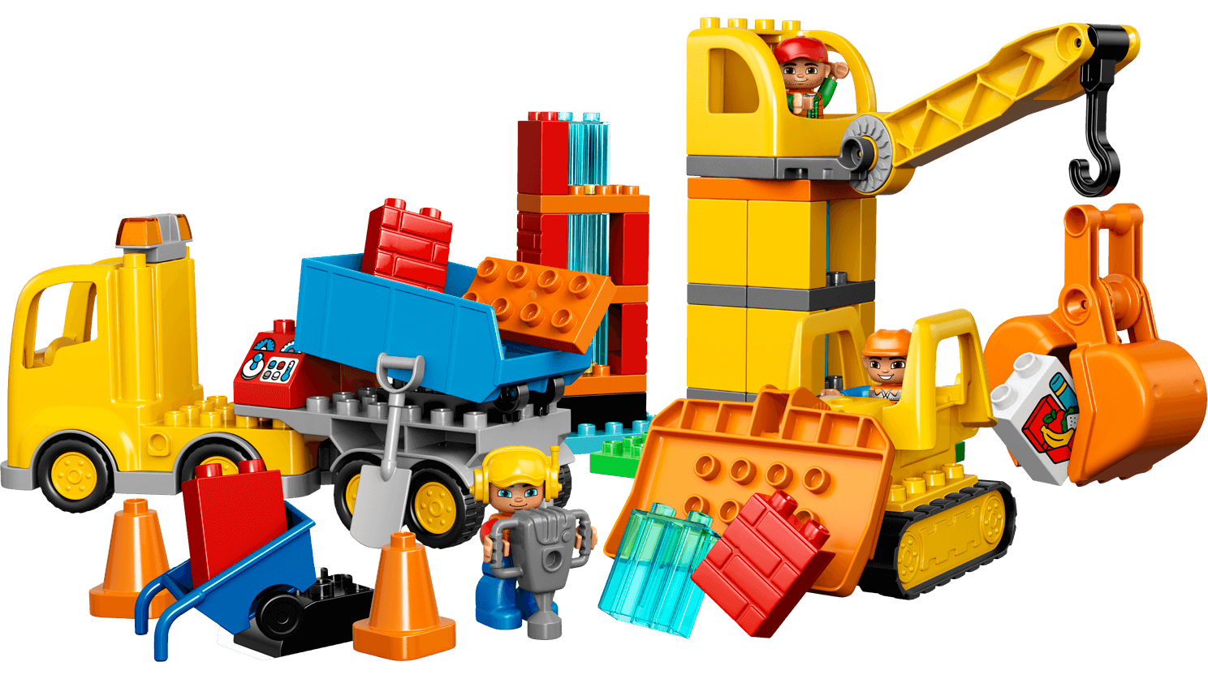
Step 6 – The get out module or technique
YOU NEVER STOP WORKING ON GET OUTS - EVER
Common Rule for Calling : “Start Small and Build on what you know”
New Callers: - Recommend you start with “Fixed point” Get out Modules
Partner line
Corner Box
RBO
Learn one Resolution Technique
Friends and Enemies
Center Box resolution
Start from what you know and build on it.

Slide 15
Handy Fixed Point Get out Modules Tim Marriner
Partner Line
Centres Square Thru 4, Outsides Allemande Left, All Right and Left Grand…
Reverse Flutter Wheel, Slide Thru, Pass the Ocean, Spin the Top, Right and Left Grand…
Right and Left Thru, Slide Thru, Eight Chain Five, Allemande Left…
Pass Thru, Tag the Line, Leads Cloverleaf, Allemande Left…
Corner Box
Touch ¼, Split Circulate, Single Hinge, Boys Cross Run, Allemande Left…
Swing Thru, Boys Run, Tag the Line, Face Out, Wheel and Deal, Zoom, Right and Left Grand…
Slide Thru, Box the Gnat, Square Thru 2, Right and Left Grand…
Right and Left Thru, Half Sashay, Pass Thru, Right and Left Grand…
Left Touch ¼, Walk and Dodge, Wheel Around, Dixie Style to a Wave, Allemande Left…
Touch ¼, Circulate, Trade, Face In, Pass Thru, Tag the Line, Leads Separate, All Right and Left Grand…
RBO
Swing Thru, Swing Thru, Spin Chain Thru, Right and Left Grand…
Touch ¼, Centres Trade, Split Circulate, Centres Trade, Square Thru 3, Trade By, Allemande Left…
Touch ¼, Split Circulate, Boys Run, Pass Thru, Wheel and Deal, Centres Wheel Around, Allemande Left…
Pass Thru, Trade By, Pass to the Centre, Square Thru 3, Allemande Left…
Box the Gnat, Pass Thru, Trade By, Left Square Thru 3, Right and Left Grand…

Slide 16
How often should I resolve?
Keep the sequence short and resolve often.
Resolving is a lot of stress that you do not need.
Keep it simple – start small and build on what you know.
Dancer success = “dancing successfully” not standing
Your first 3 sequences.
Open with a memorized “ring” figure
Follow with a memorised short (10-12 max) sequence
Follow with a key couple /resolution confidence builder

Slide 17
Newer Caller Final calling hints and tips
If you are calling and a square breaks – Resolve
If your resolution takes to long – forget it
FAIL = First Attempt In Learning
If you do this – you will have respect – you made a mistake
You give the dancers respect and don’t waste their time
It shows you are honest and puts them on your side
Study your key couples – memorise them
Don’t start calling until you are sure you have them memorised
Start from what you know and build on it.

Slide 18
Questions and Discussion

